Slide 1
Develop a virtual intrusion detection system (vIDS) based on containers
Linyu Zhang Zhechao Sui Jie Hao Biyang Fu

Slide 2
01
Background
04
Modules
02
Platforms
CONTENTS
05
Demo
03
Architecture
Notes:
We will introduce our project in 5 parts.

Slide 3
01 Background
- Motivation
Network ​​security is gaining more and more attention
Create a gap when modify the matching rules
SDN megatrends
- Objectives
Develop a virtual intrusion detection system (vIDS) based on Snort
Change the rules without rebooting the IDS
Deploy the IDS to SDN architecture
Notes:
Snort is a powerful IDS tool. It can perform protocol analysis and search / match the content of network data packets. It also can detect various attack methods and provide real-time alarm to the attack.
In IDS, if you need to change the matching rules, you usually need to stop the IDS network, then modify the rules, and reconfigure. However, in the process of restarting IDS, we lost the detection function of packets. Some malicious or unknown sources of packets may use this gap to escape the monitoring of the system. So, we also realize the function that change the rules without rebooting the IDS based on snort.
Under the current general trend of SDN, we deploy IDS into the SDN architecture.

Slide 4





02 Platforms
- Platforms
VirtualBox 6.1.0
ubuntu 18.04
Snort 2.9.15.1
Open vSwitch 2.9.5
Ryu 4.15
Notes:
Here are all platforms we used in our project. First, we create the virtual machine of ubuntu 18.04 on VirtualBox. And build our architecture based on Snort, Open vSwitch and Ryu.

Slide 5
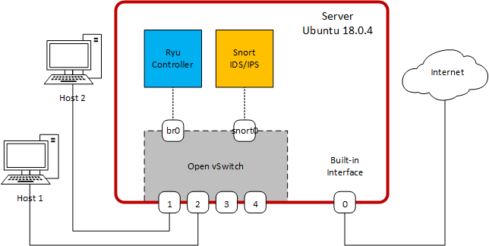
03 Architecture
- Architecture
Notes:
Here is the diagram of our architecture. We install and configure Ryu controller and Snort intrusion detection system on our ubuntu virtual machine. In order to connect all components used in our project, which include Ryu controller, Snort, Internet and hosts, we create an OpenFlow switch by using Open vSwitch and deploy interfaces.

Slide 6
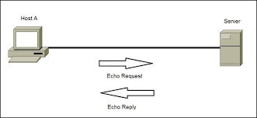


04 Snort IDS Module
Ping
Host A
(10.0.2.15)
Host B
(192.168.56.101)
Notes:
The basis of our experiment is based on the connection between two hosts. We use host A to ping Host B. Here are their IP addresses. When we ping IP address of Host B from Host A, the ping command will first send an ICMP Echo Request to Host B. After receiving it, Host B will return an ICMP Echo Reply. If it does not return, it is timed out, and the specified network address will not be considered to exist. Here is the matching rule. And this is the revised rule. Snort can monitor packets according to these rules.

Slide 7
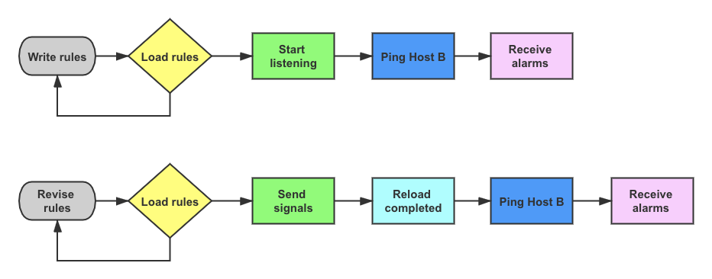
04 Snort IDS Module
Flow chart of Snort IDS
Notes:
At first, we write the matching rule, and load it. If the load fails, you need to modify your rules to match snort's configuration. Next, we start listening. We can not see anything now, because we haven't start connecting. So we open a new terminal to ping IP address of Host B. If it is successfully connected, we can receive the alarms based on the matching rule.
Next step, we should realize changing rules without rebooting IDS. We keep the snort working and open another terminal. We revise the rule and make sure it can be loaded successfully. Then, we send signals to tell snort that we have reloaded a new rule. Snort IDS will show the result of reload completed. We ping Host B again, and get the alarms according to our revised rules.

Slide 8
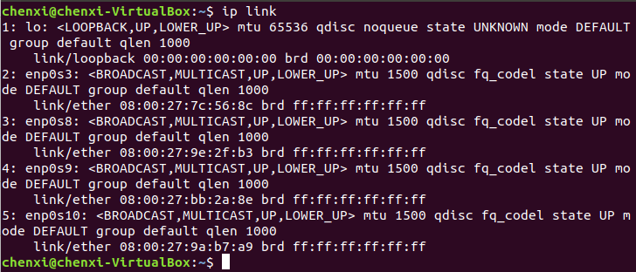
05 Deploying SDN Environment
1) Add more network adapters on VM.
Notes:
Our second module aims to deploy our architecture in SDN environment. After installing all components we need, we implement this module in several steps. Firstly, we add more network adapters on out virtual machine for necessary connections. As you can see, they are named as enp0s3, 8, 9, and 10.

Slide 9
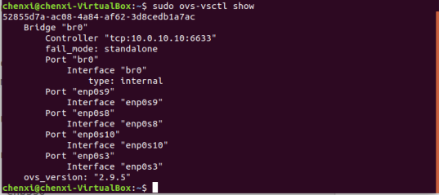
05 Deploying SDN Environment
2) Create an OpenFlow switch and connect it to hosts and Ryu controller.
Notes:
Secondly, we create an OpenFlow Switch using Open vSwitch and add the four Ethernet ports to it. Then we connect the switch with hosts and Ryu controller to exchange OpenFlow packets and populate its flow tables. The figure shows the network configuration.

Slide 10
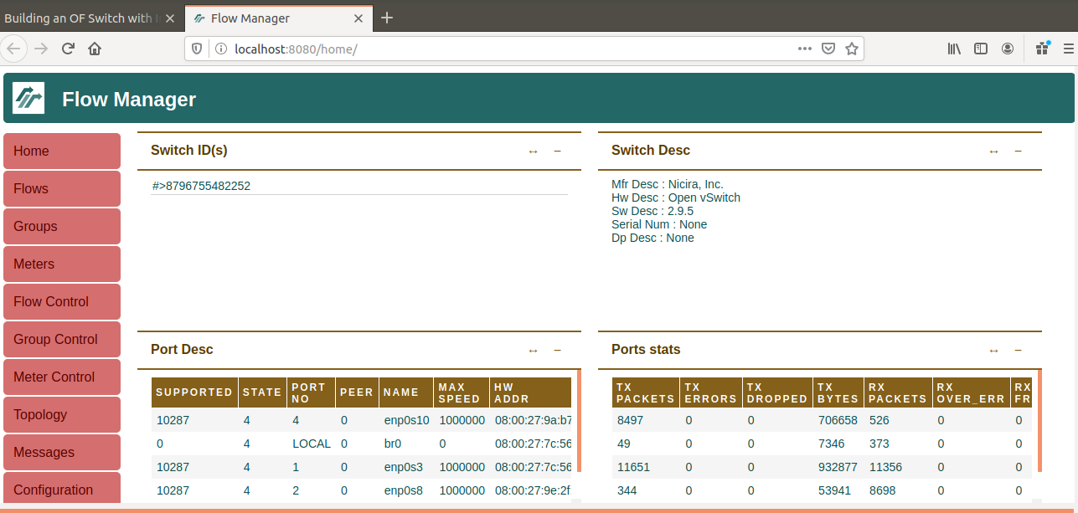
05 Deploying SDN Environment
3) Run Ryu controller and install FlowManager.
Notes:
In the third step, we run Ryu controller which is a component-based software defined networking framework, and it supports various protocols for managing network devices. Also we activate the FlowManager application which provides a user-friendly interface to modify and monitor the flow tables in the network. This figure shows that the controller connected to the switch successfully.

Slide 11
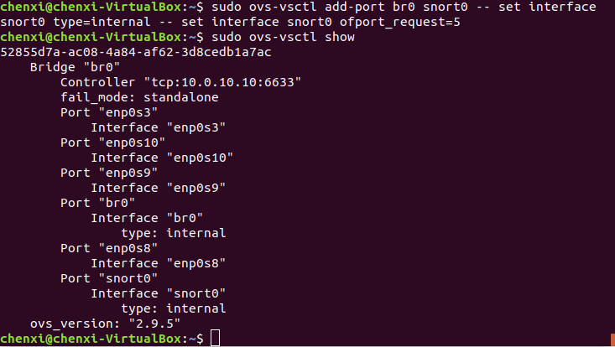
05 Deploying SDN Environment
4) Add an internal port to the switch for Snort IDS.
Notes:
In the fourth step, we integrate Snort into our environment. We create an interface connected to a switch port to receive packets for analysis. As you can see, the port is named as 'snort0'.

Slide 12
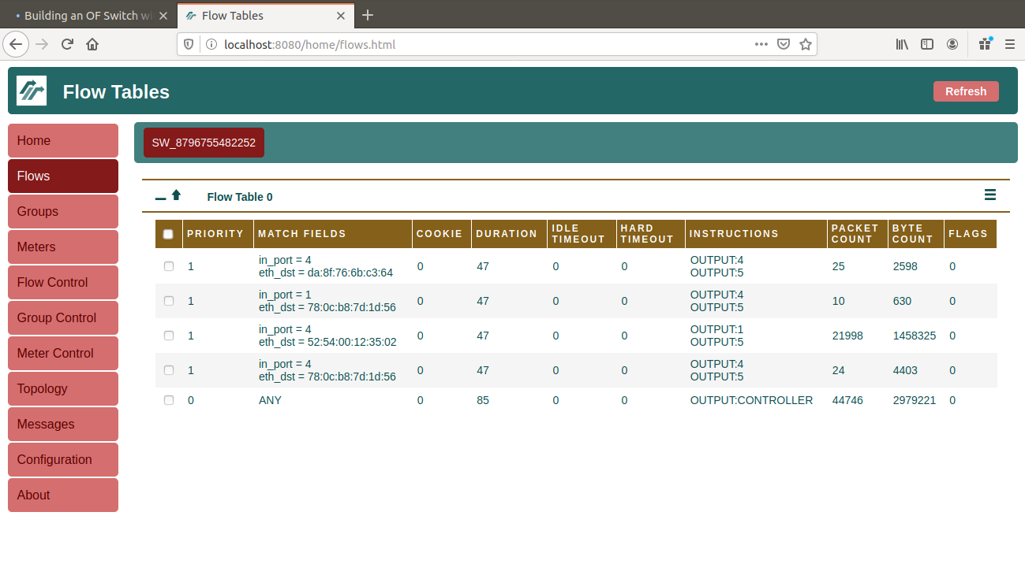
05 Deploying SDN Environment
5) Link Snort IDS to Ryu.
Notes:
In the last step, we utilize a script provided by Ryu to link Snort IDS to Ryu. Here shows the flow table on FlowManager page. The FlowManager shows that the flows added include additional OUTPUT action that copies packets to port 5.

Slide 13
04 Demo
Demo

Slide 14
Thank you!

